Slide 1
Java Generics
In Java
Author: Denis Kohanevich

Slide 2
Motivation
Stronger type checks at COMPILE time.
Elimination of casts.
Generics add stability to your code.

Slide 3
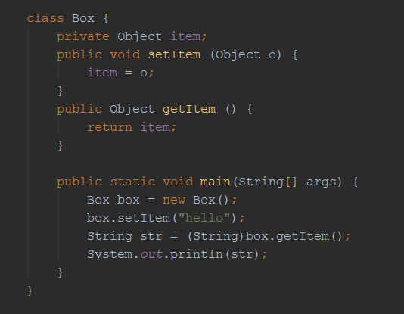
Before Java 1.5

Slide 4
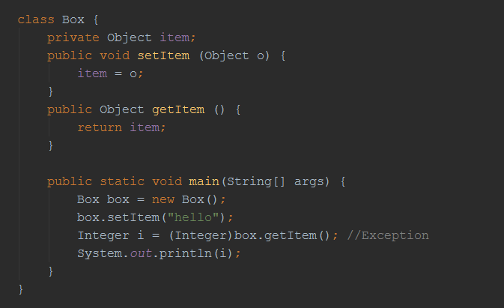
Potential problems

Slide 5
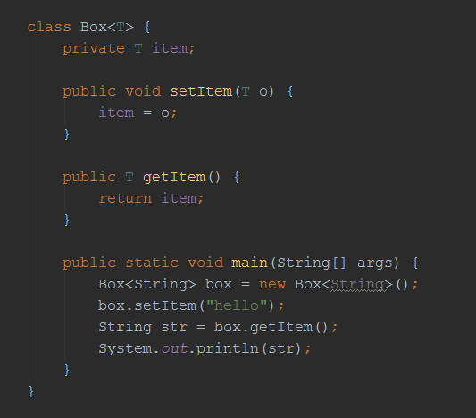
Using Generics

Slide 6
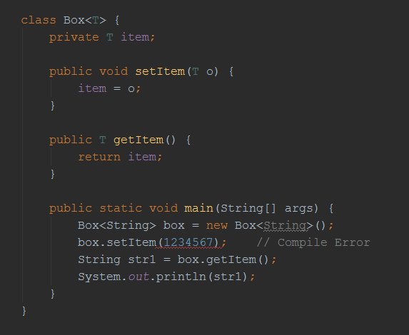
Using Generics

Slide 7
Generic Types & Naming Convention
  E - Element (Java Collections Framework)
  K - Key
  N - Number
  T - Type
  V - Value
  S,U,V etc. - 2nd, 3rd, 4th types

Slide 8
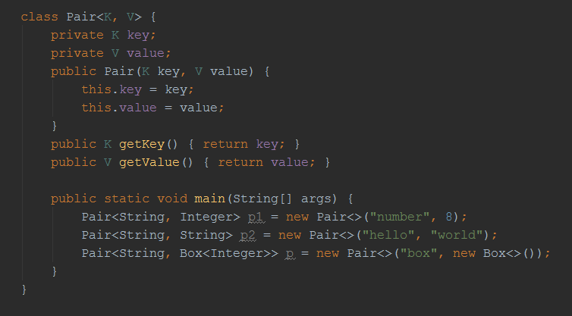
Generics example

Slide 9
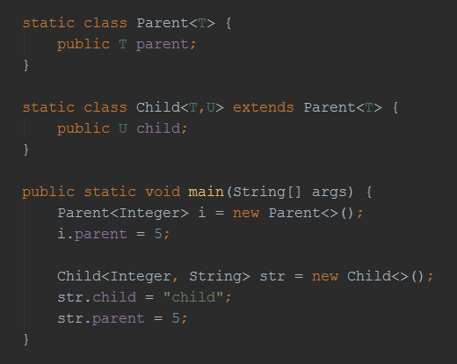
Generics example

Slide 10
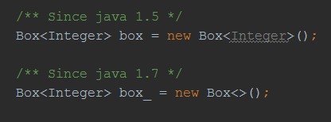
The Diamond

Slide 11

Raw Types

Slide 12
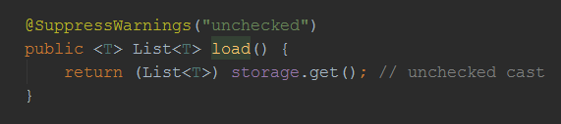
Suppress Warnings

Slide 13
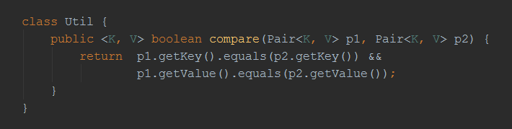
Generic Methods

Slide 14
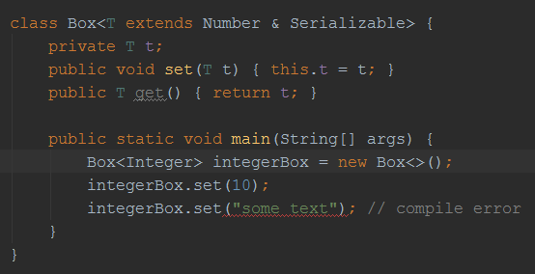
Bounded Type Parameters

Slide 15
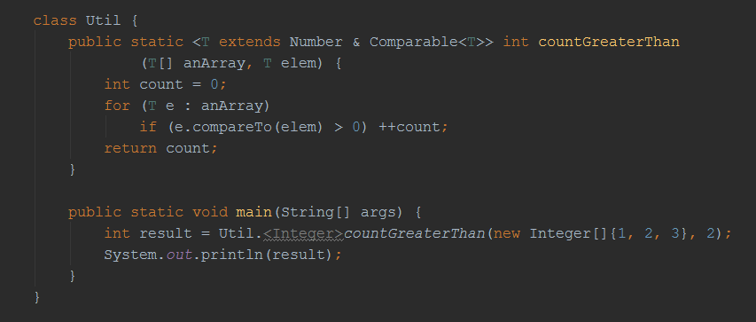
Generic example

Slide 16
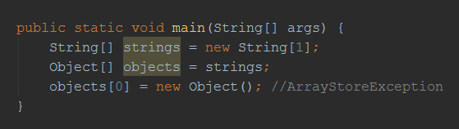
Arrays inheritance problem

Slide 17
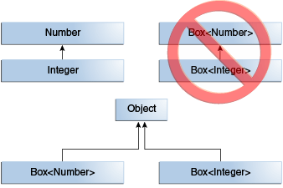
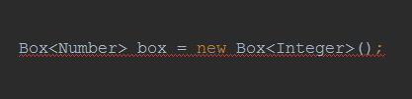
Generics, Inheritance, and Subtypes

Slide 18
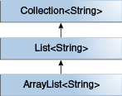
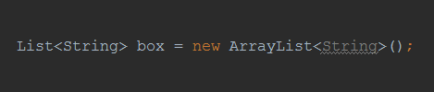
Generic Classes and Subtyping

Slide 19
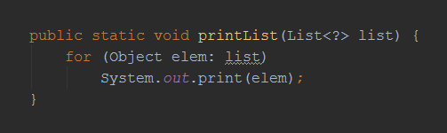
Wildcards. Unbounded Wildcards

Slide 20
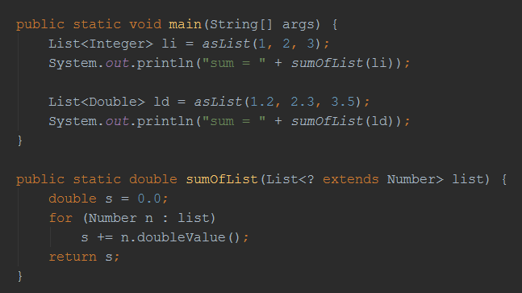
Upper Bounded Wildcards

Slide 21
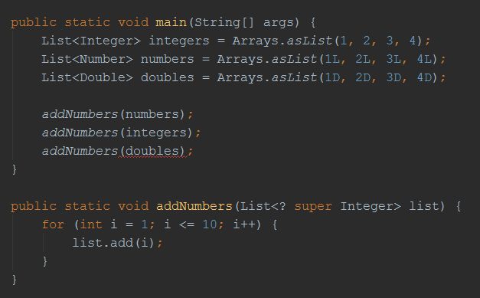
Lower Bounded Wildcards

Slide 22
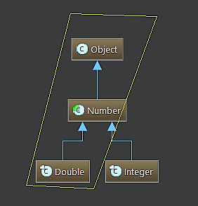
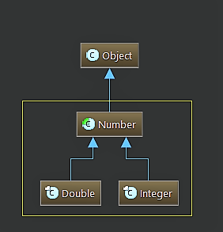
<? super Type> vs <? extends Type>
<? super Double> <? extends Number>

Slide 23
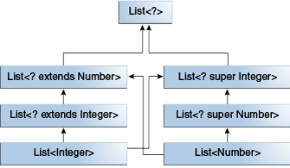
Wildcards and Subtyping

Slide 24
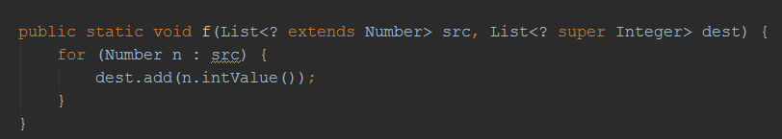
Generics example. PESC

Slide 25
Type Erasure
Replace all type parameters in generic types with their bounds or Object.
Insert type casts if necessary to preserve type safety.
Generate bridge methods to preserve polymorphism in extended generic types.

Slide 26
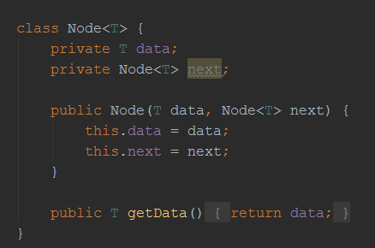
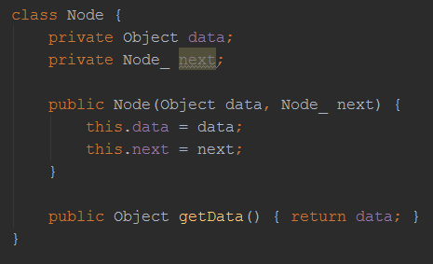
Type Erasure example

Slide 27
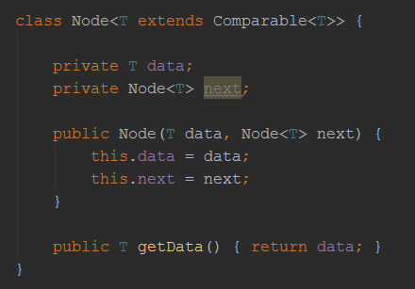
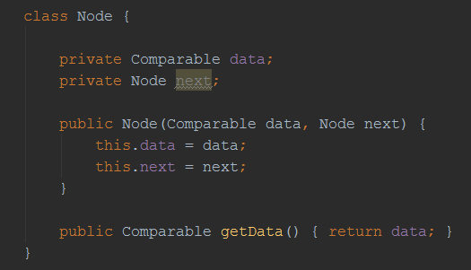
Type Erasure example

Slide 28
Restrictions on Generics
To use Java generics effectively, you must consider the following restrictions:
Cannot Instantiate Generic Types with Primitive Types
Cannot Create Instances of Type Parameters
Cannot Declare Static Fields Whose Types are Type Parameters
Cannot Use Casts or instanceof With Parameterized Types
Cannot Create Arrays of Parameterized Types
Cannot Create, Catch, or Throw Objects of Parameterized Types
Cannot Overload a Method Where the Formal Parameter Types of Each Overload Erase to the Same Raw Type

Slide 29
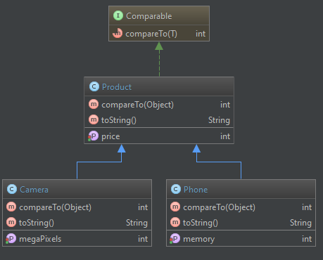
Practice

Slide 30
Thanks!
Q & A

